Slide 1
ACID-BASE BALANCE
Arun R Nair
Assistant Professor

Slide 2
Proper physiological functioning depends on a very tight balance between the concentrations of acids and bases in the blood.
Acid-balance balance is measured using the pH scale.
A variety of buffering systems permits blood and other bodily fluids to maintain a narrow pH range, even in the face of perturbations.
A buffer is a chemical system that prevents a radical change in fluid pH by dampening the change in hydrogen ion concentrations in the case of excess acid or base.
Most commonly, the substance that absorbs the ions is either a weak acid, which takes up hydroxyl ions, or a weak base, which takes up hydrogen ions.

Slide 3
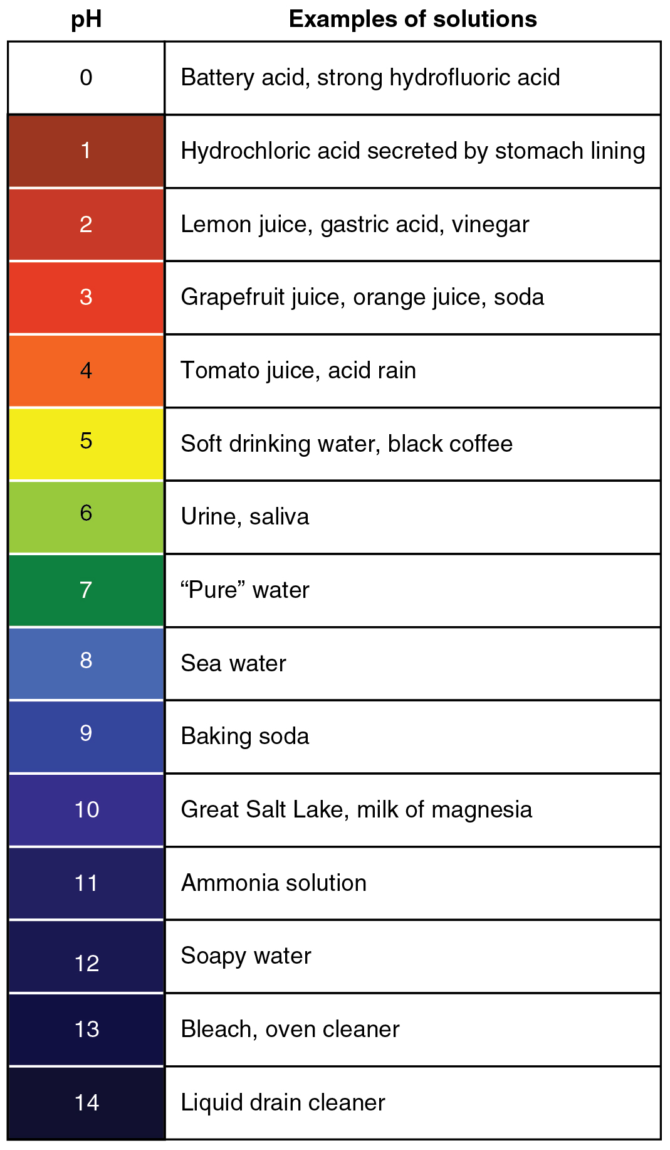

Slide 4
BUFFER SYSTEMS
Blood as a Buffer. It contains a buffer of carbonic acid (H2CO3) and bicarbonate anion (HCO3-) in order to maintain blood pH between 7.35 and 7.45, as a value higher than 7.8 or lower than 6.8 can lead to death.
In this buffer, hydronium and bicarbonate anion are in equilibrium with carbonic acid.
Furthermore, the carbonic acid in the first equilibrium can decompose into CO2 gas and water, resulting in a second equilibrium system between carbonic acid and water.
Because CO2 is an important component of the blood buffer, its regulation in the body, as well as that of O2 , is extremely important.

Slide 5
The effect of this can be important when the human body is subjected to strenuous conditions.
In the body, there exists another equilibrium between hydronium and oxygen which involves the binding ability of hemoglobin.
An increase in hydronium causes this equilibrium to shift towards the oxygen side, thus releasing oxygen from hemoglobin molecules into the surrounding tissues/cells.
This system continues during exercise, providing continuous oxygen to working tissues.

Slide 6
The body's chemical buffer system consists of three individual buffers:
The carbonate/carbonic acid buffer, the phosphate buffer and the buffering of plasma proteins.
While the third buffer is the most plentiful, the first is usually considered the most important since it is coupled to the respiratory system.
Carbonic acid (H₂CO₃) is a weak acid and is therefore in equilibrium with bicarbonate (HCO₃⁻) in solution. When significant amounts of both carbonic acid and bicarbonate are present, a buffer is formed.
This buffer system as:

Slide 7
Under normal circumstances there is much more bicarbonate present than carbonic acid (the ratio is approximately 20:1).
As normal metabolism produces more acids than bases, this is consistent with the body's needs.
The blood, with its high base concentration, is able to neutralize the metabolic acids produced.
Since relatively small amounts of metabolic bases are produced, the carbonic acid concentration in the blood can be lower.
Since carbonic acid is not stable in aqueous solutions some of it decomposes to form carbon dioxide and water.
The respiratory system is responsible for removing the carbon dioxide.

Slide 8
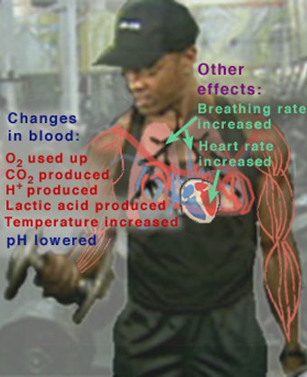
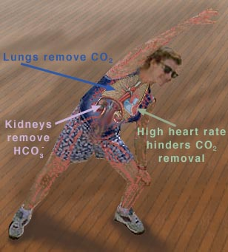
By combining the two reactions of carbonic acid :

Slide 9
CARBONIC ACID BICARBONATE BUFFER.
Cellular respiration produces carbon dioxide as a waste product. This is immediately converted to bicarbonate ion in the blood.
On reaching the lungs it is again converted to and released as carbon dioxide.
While in the blood , it neutralises acids released due to other metabolic processes.
In the stomach and deudenum it also neutralises gastric acids and stabilises the intra cellular pH of epithelial cells by the secretions of bicarbonate ions into the gastric mucosa.

Slide 10
PHOSPHATE BUFFER SYSTEM
Phosphate buffer system operates in the internal fluids of all cells.
It consists of dihydrogen phosphate ions as the hydrogen ion donor ( acid ) and hydrogen phosphate ion as the ion acceptor ( base ) .
If additional hydroxide ions enter the cellular fluid, they are neutralised by the dihydrogen phosphate ion.
If extra hydrogen ions enter the cellular fluid then they are neutralised by the hydrogen phosphate ion.

Slide 11
PROTEIN BUFFER SYSTEM
Protein buffer system helps to maintain acidity in and around the cells.
Haemoglobin makes an excellent buffer by binding to small amounts of acids in the blood, before they can alter the pH of the blood.
Other proteins containing amino acid histidine are also good at buffering.

Slide 12
The main purpose of all these buffers is to maintain proper pH within the body system so that all biochemical process can take place.
The blood buffer is:
Maintaining a constant blood pH is critical for the proper functioning of our body.

Slide 13
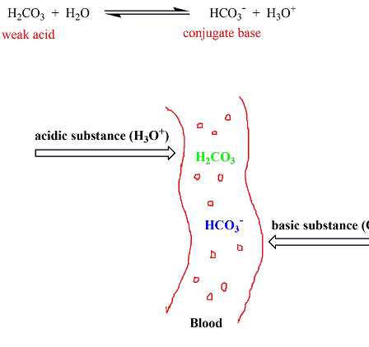
The buffer that maintains the pH of human blood involves a carbonic acid (H2​CO3)​- bicarbonate ion (HCO3​) system.
When any acidic substance enters the bloodstream, the bicarbonate ions neutralize the hydronium ions forming carbonic acid and water.
Carbonic acid is already a component of the buffering system of blood.
Thus hydronium ions are removed, preventing the pH of blood from becoming acidic

Slide 14
when a basic substance enters the bloodstream, carbonic acid reacts with the hydroxide ions producing bicarbonate ions and water.
Bicarbonate ions are already a component of the buffer.
In this manner, the hydroxide ions are removed from blood, preventing the pH of blood from becoming basic.

Slide 15
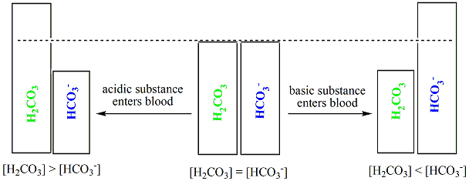
In the process of neutralizing hydronium ions or hydroxide ions, the relative concentrations of carbonic acid (H2​CO3​) and bicarbonate ions (HCO3​) fluctuate in the blood stream.
But this slight change in the concentrations of the two components of the buffering system doesn’t have any adverse effect; the critical thing is that this buffering mechanism prevents the blood from becoming acidic or basic, which can be detrimental.
The pH of blood is maintained at ~ 7.4 by the carbonic acid – bicarbonate ion buffering system.

Slide 16
Enzymes are very specific in nature, and function optimally at the right temperature and the right pH; if the pH of blood goes out of range, the enzymes stop working and sometimes enzymes can even get permanently denatured, thus disabling their catalytic activity.
This in turn affects a lot of biological processes in the human body, leading to various diseases.

